Slide 1
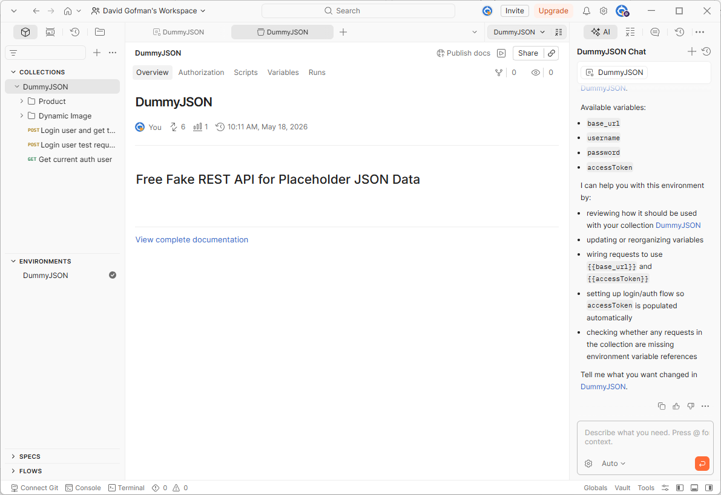

In this tutorial, we will use JPostman, a lightweight Java library for reusing exported Postman collections and environments in Java API tests.

Slide 2
You can review the project documentation and examples on GitHub at github.com/JPostman/jpostman.

Slide 3
After opening Postman, we will review a simple API collection based on DummyJSON, a free fake REST API that provides placeholder JSON data for development, testing, and prototyping.

Slide 4
Here we have a Postman collection named DummyJSON. It contains example requests such as login, getting the current authenticated user, product APIs, and dynamic image APIs.

Slide 5
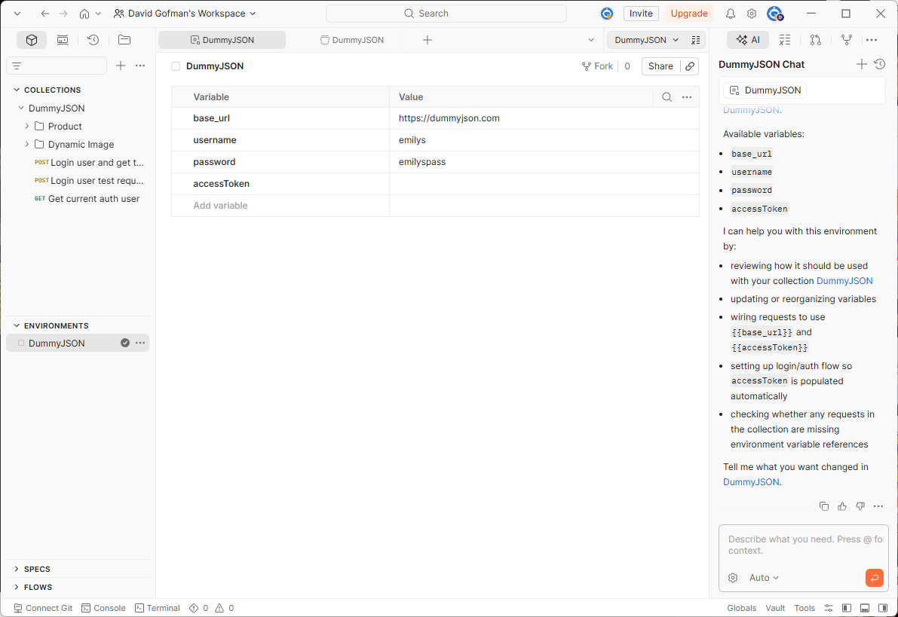
Before running the requests, let’s review the environment I created for testing. The environment stores variables such as base_url, username, password, and accessToken.

Slide 6
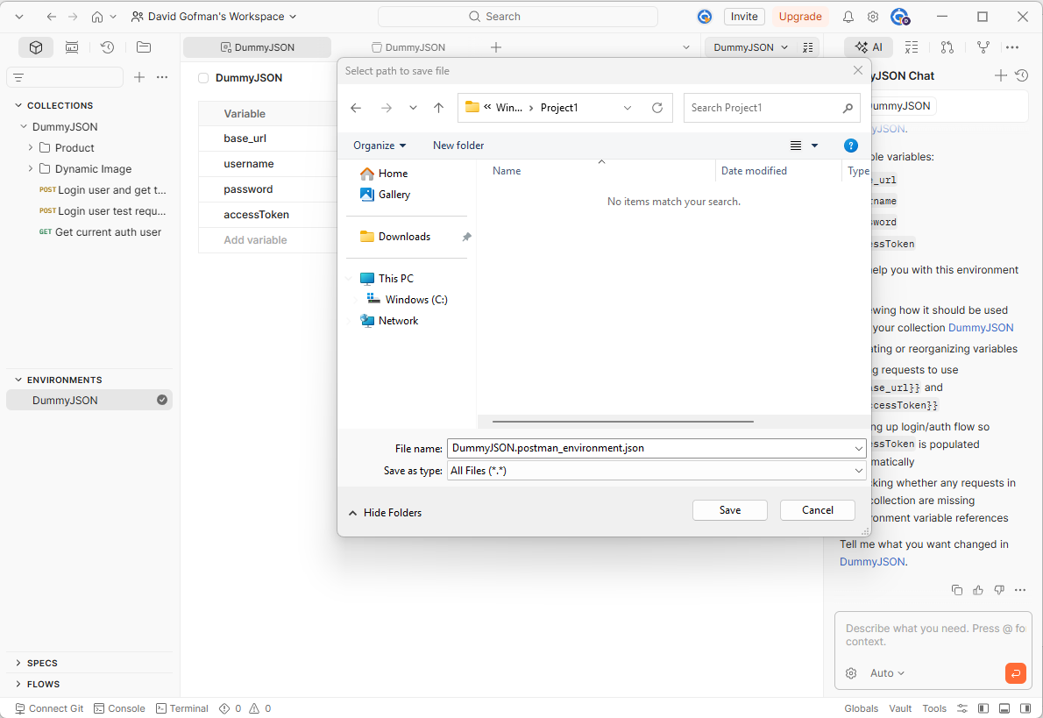
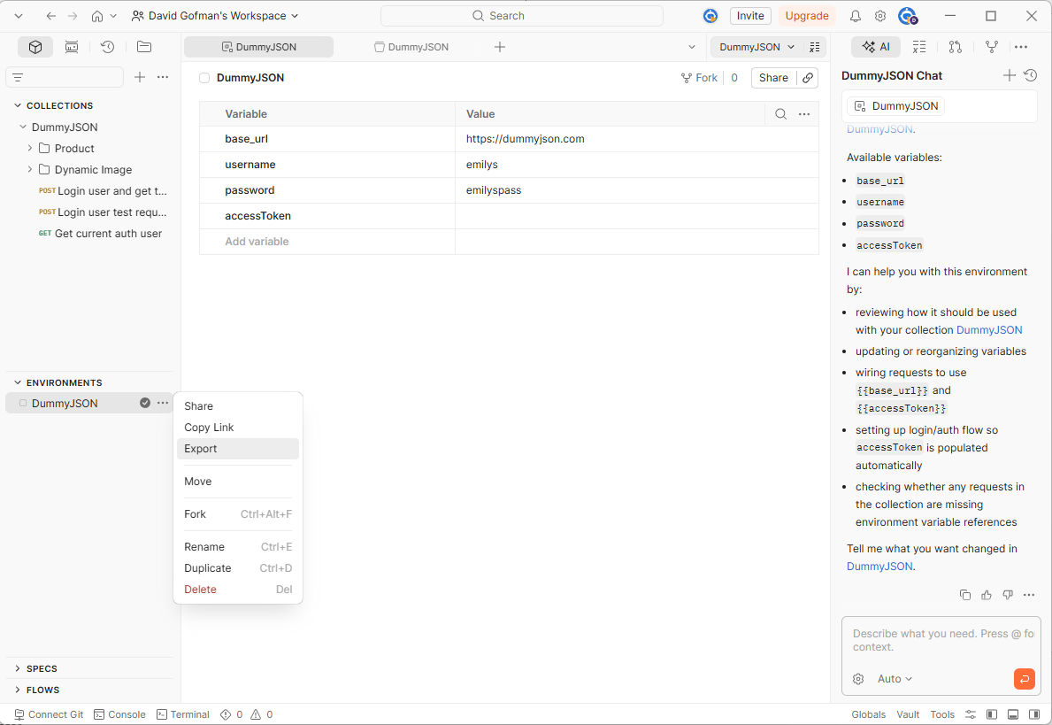
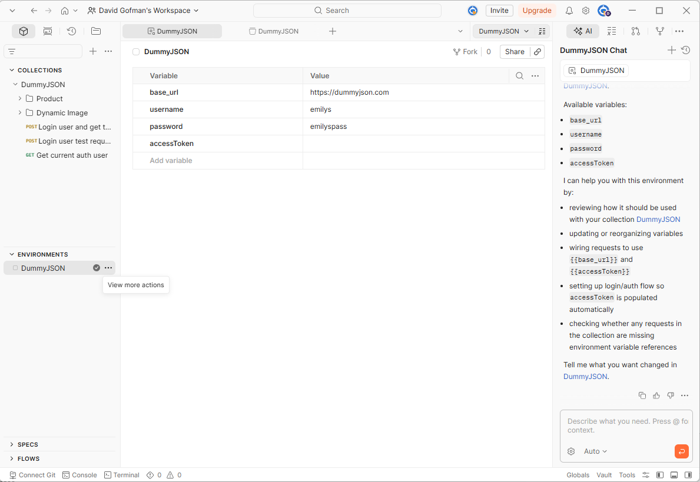
Now that we understand the environment setup, let’s export it for our Java API test project. Move the mouse over the three dots next to the DummyJSON environment, click Export, and Save the environment JSON file into the Java project’s resources directory.

Slide 7
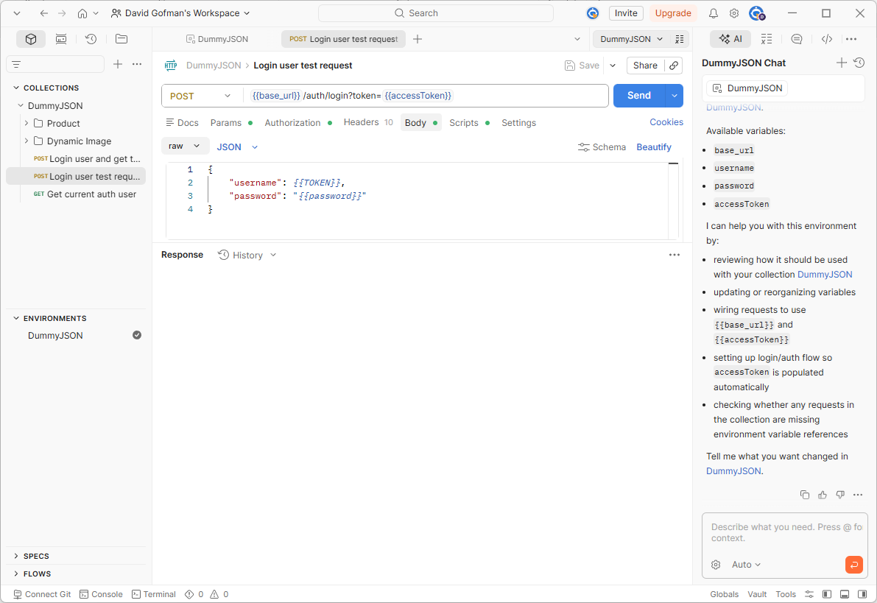
Before exporting the collection, let’s review how template variables are defined. In Postman, we can reference environment values by using double curly braces. These placeholders should be resolved from the selected environment before the request is executed.

Slide 8
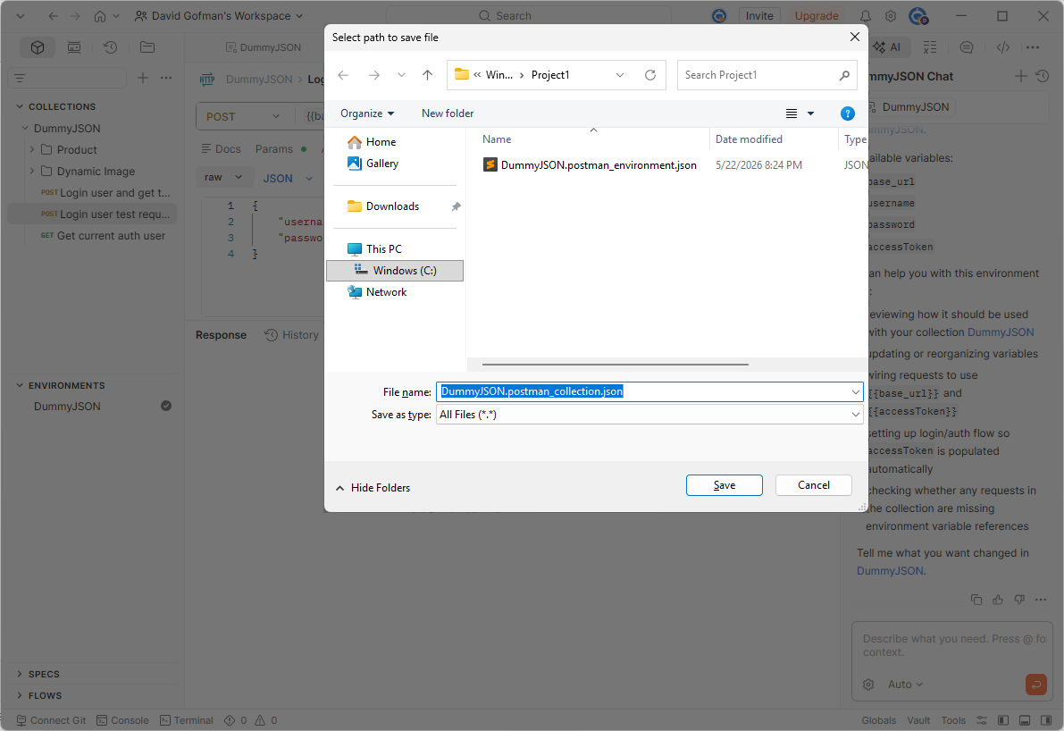
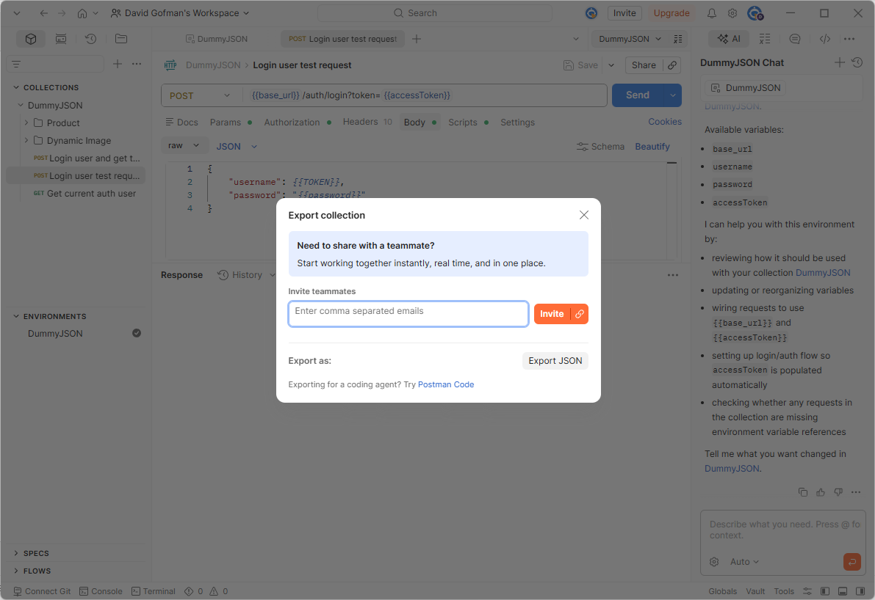
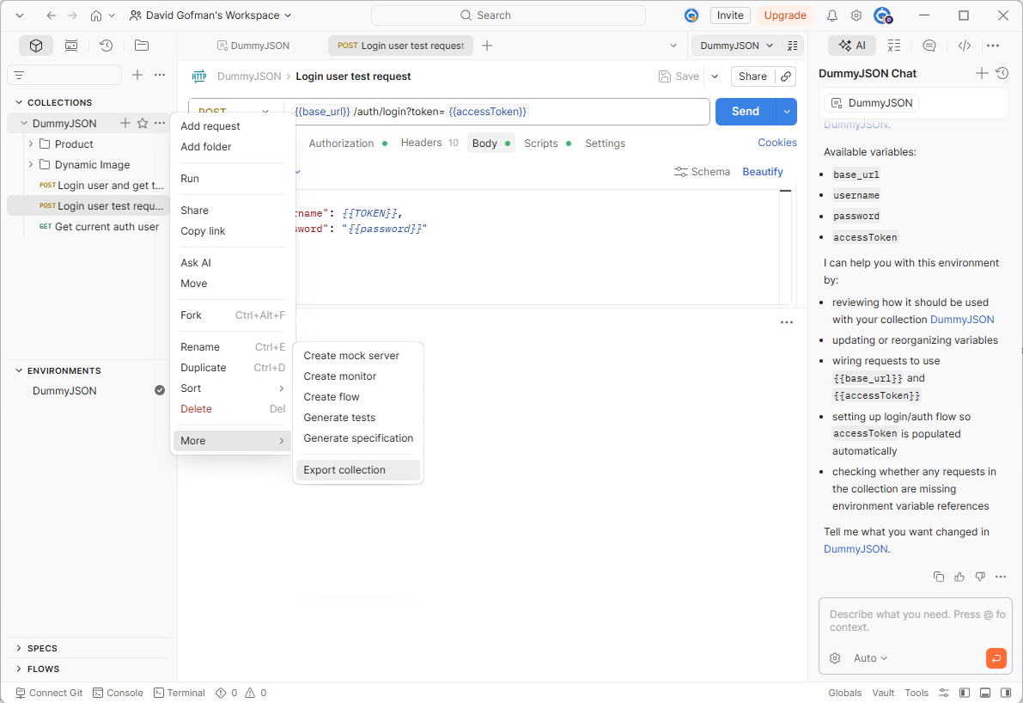
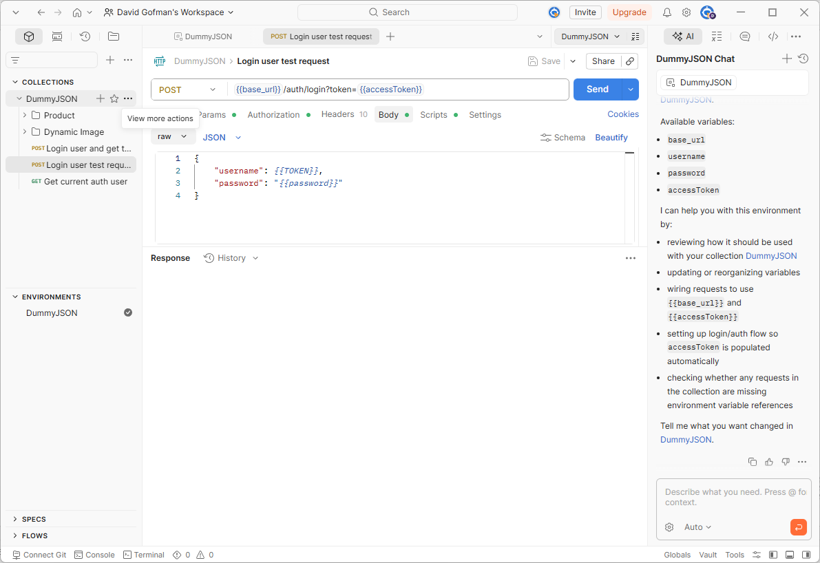
Now let’s export the Postman collection. Move the mouse over the three dots next to the DummyJSON collection, click More actions, choose Export, and Save the collection JSON file into the same Java project resources directory.

Slide 9
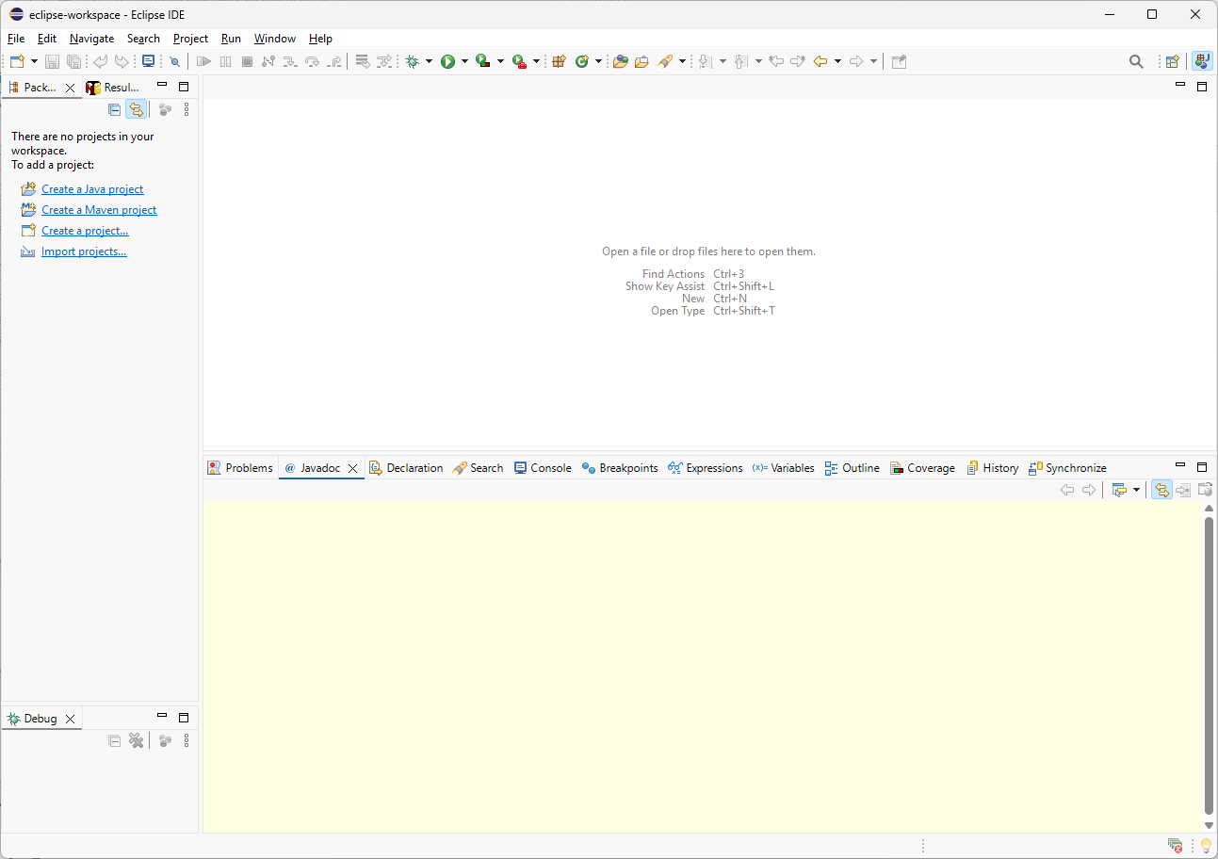
For this tutorial, I will use Eclipse IDE, but you can use any Java IDE that supports Maven projects. Start by clicking Create a Maven project.

Slide 10
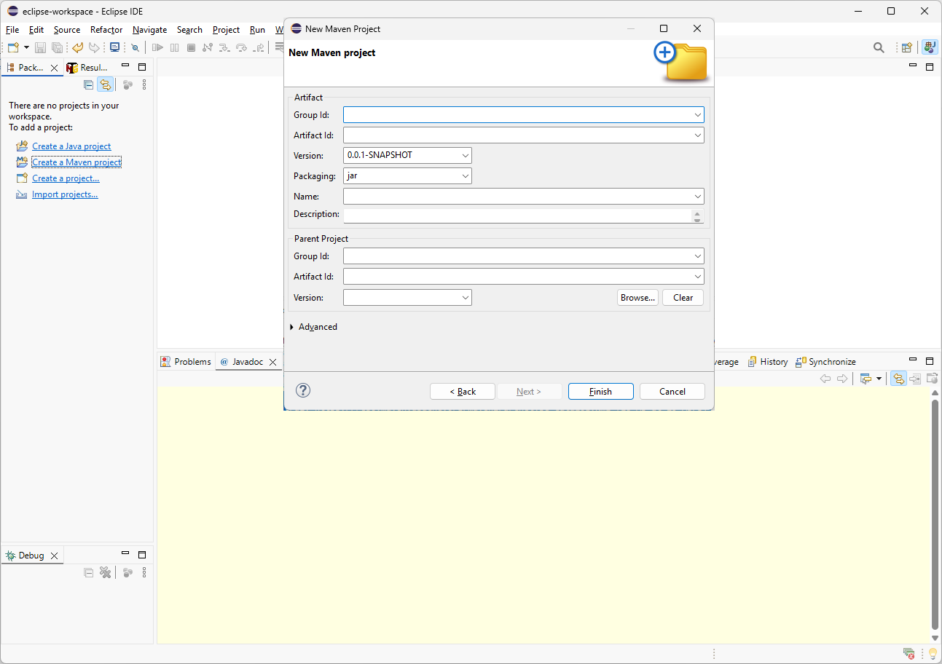
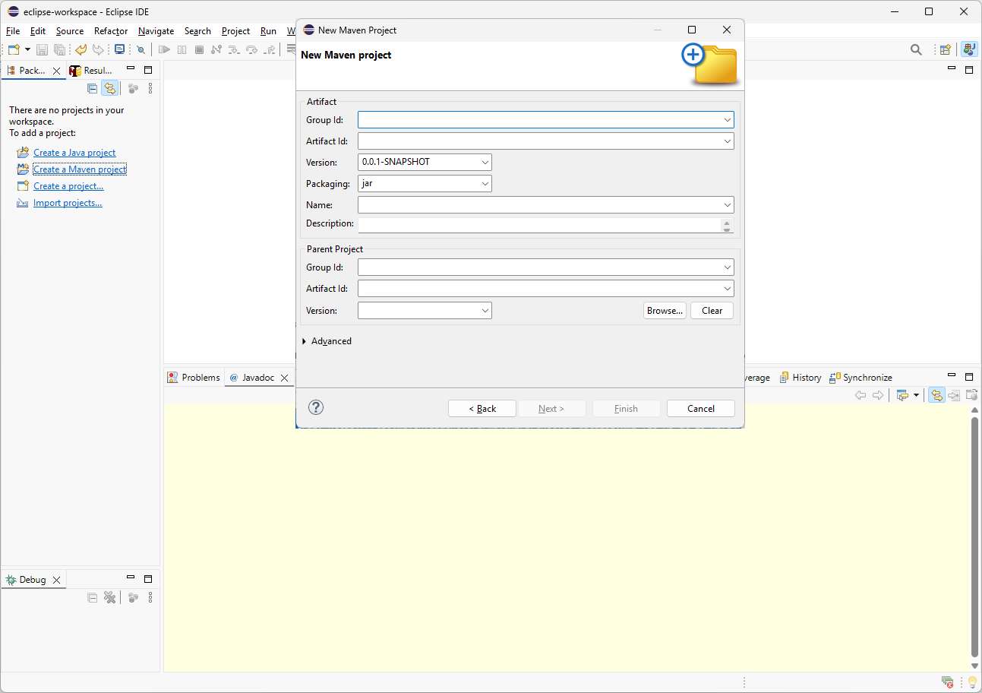
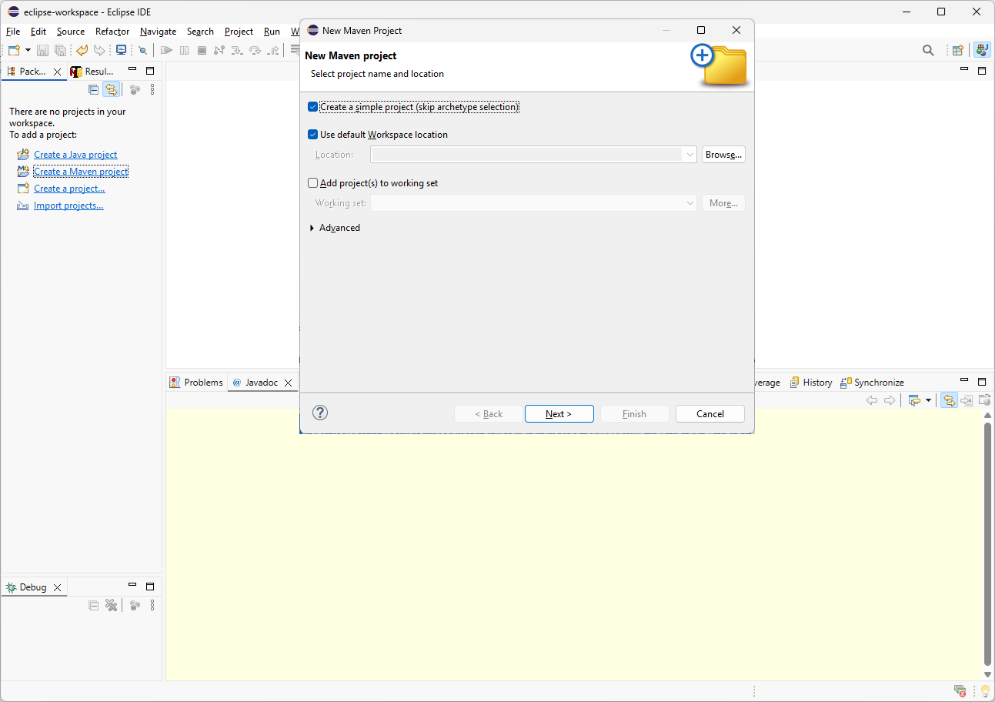
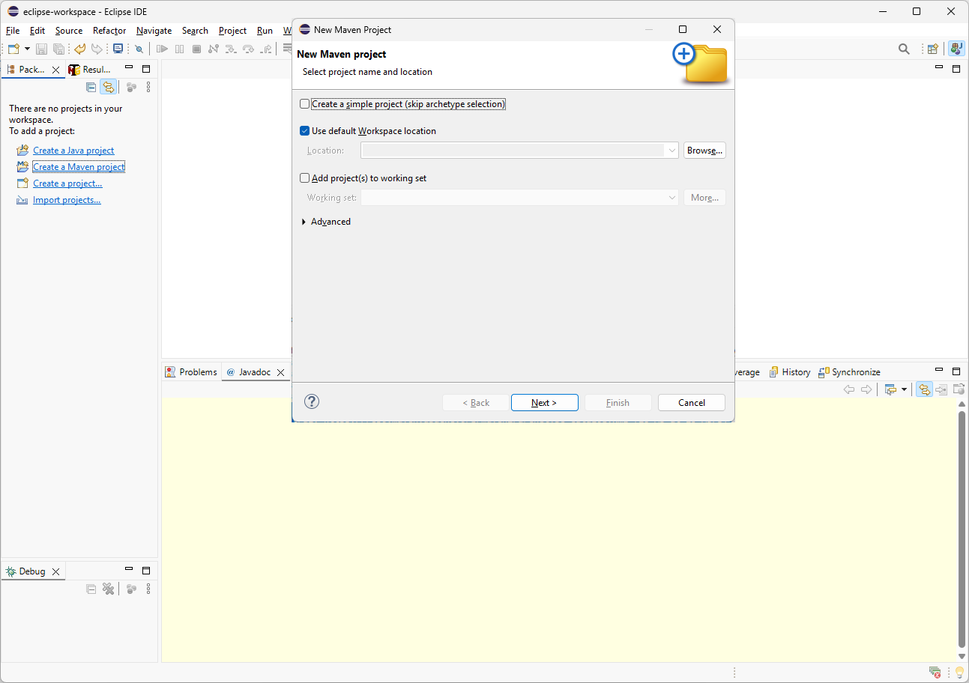
com.example
jpostman-demo
Enter your Maven project information, such as Group ID and Artifact ID. Then click Finish to create the project.
On the New Maven Project screen, select Create a simple project, which skips archetype selection. Then click Next.

Slide 11
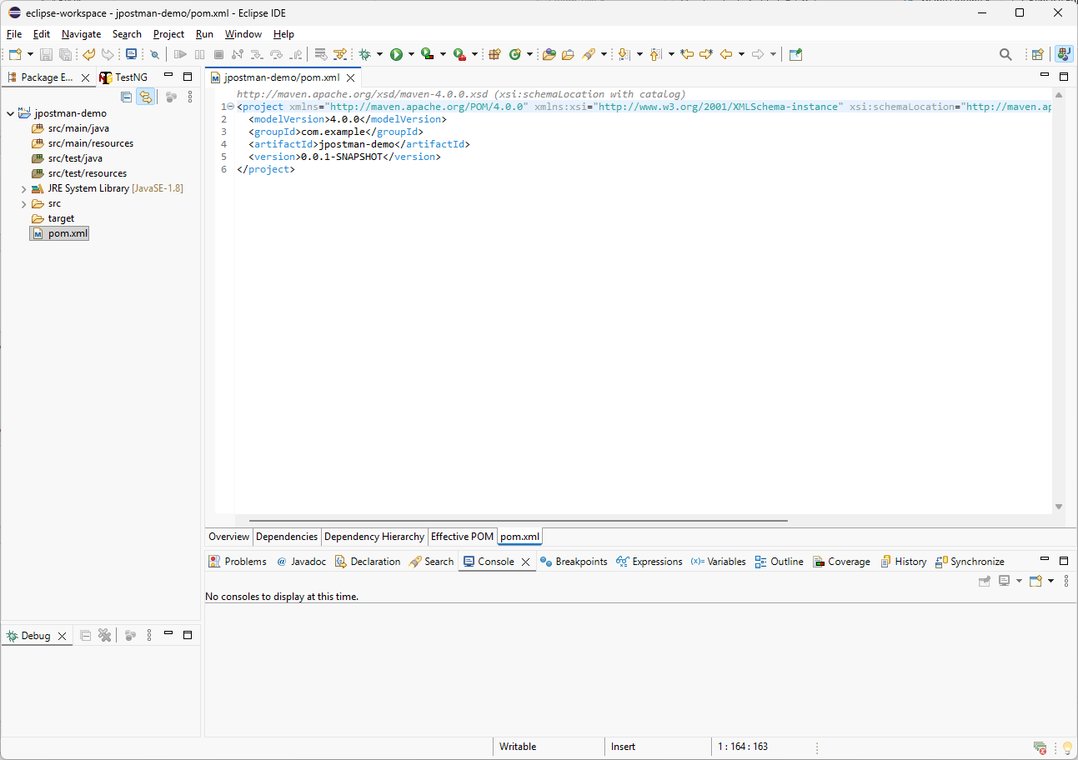
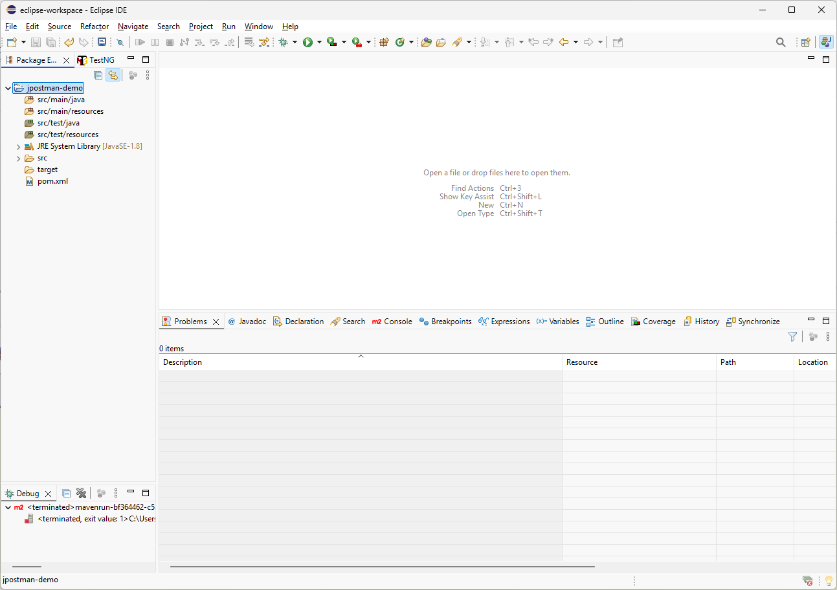
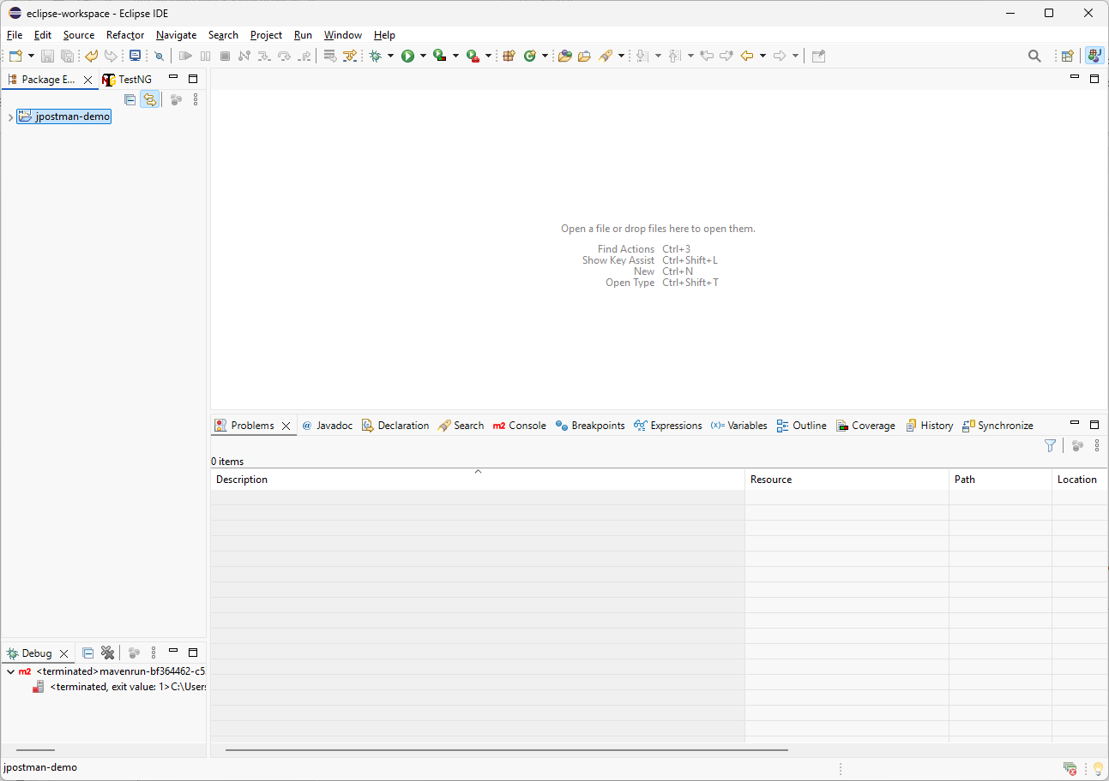
After the project is created, expand the new project in the Eclipse project tree and double-click the pom.xml file. This is where we will add JPostman as a Maven dependency.

Slide 12
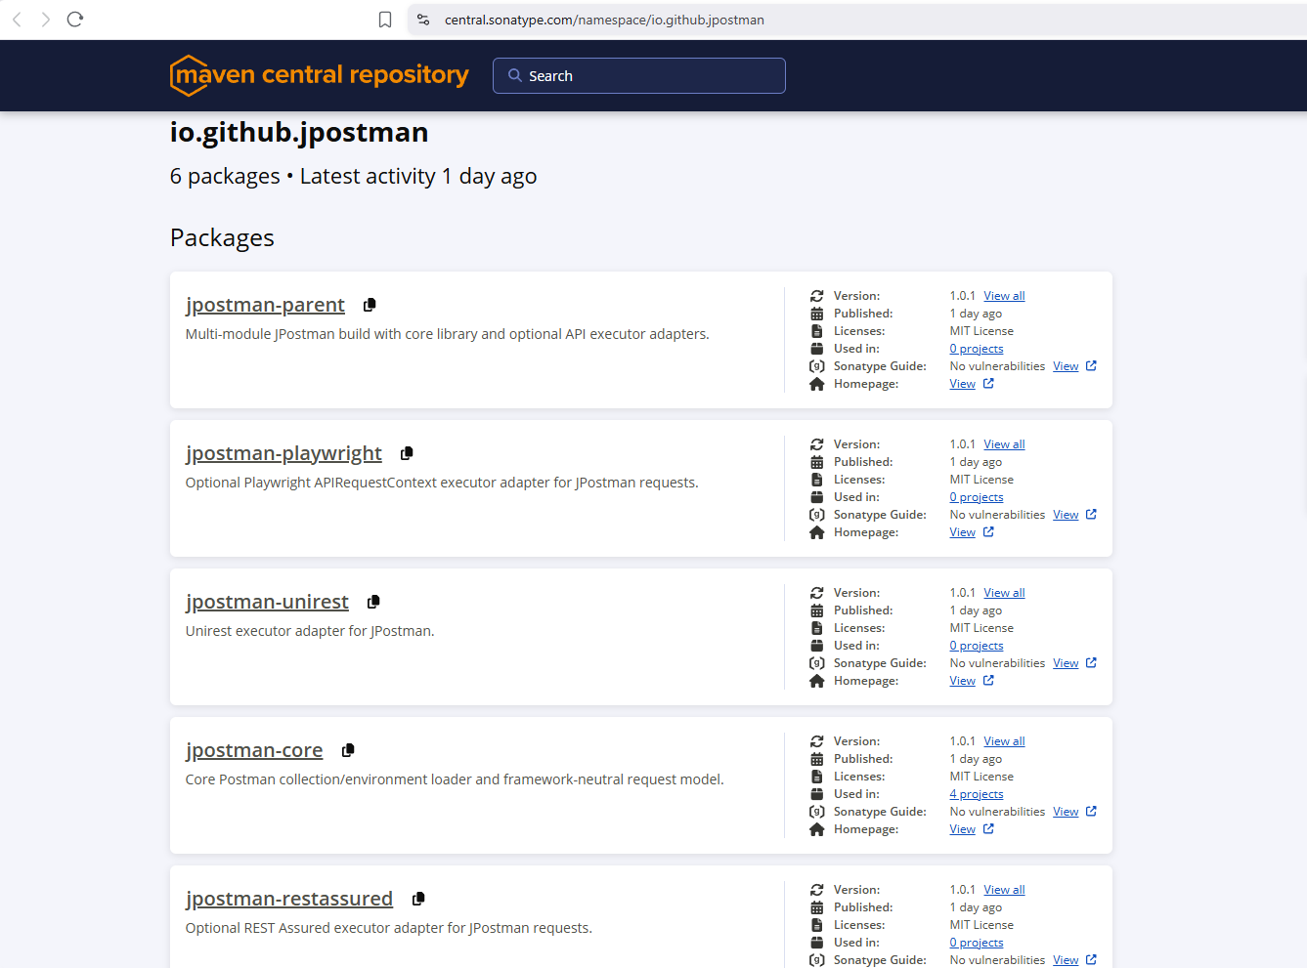
Let’s review the available JPostman Maven dependencies. jpostman-core is the main library, while the other packages are optional REST API executor adapters.

Slide 13
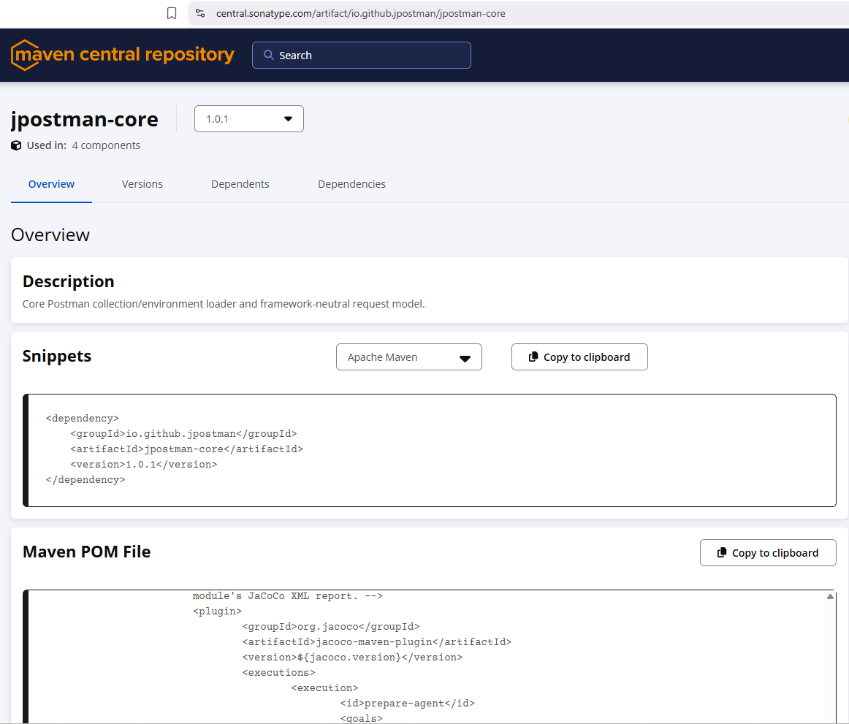
You can find this Maven Central link in the video description or in the GitHub documentation. For now, I will copy the jpostman-core dependency to the clipboard so we can add it to the project’s pom.xml file.

Slide 14
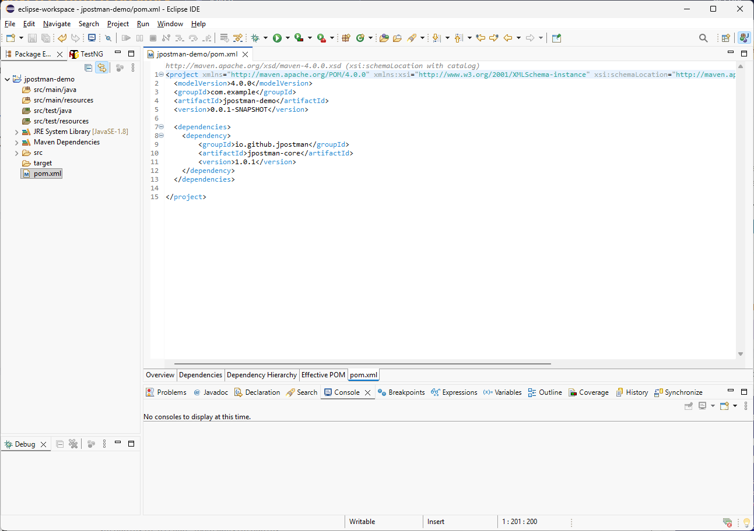
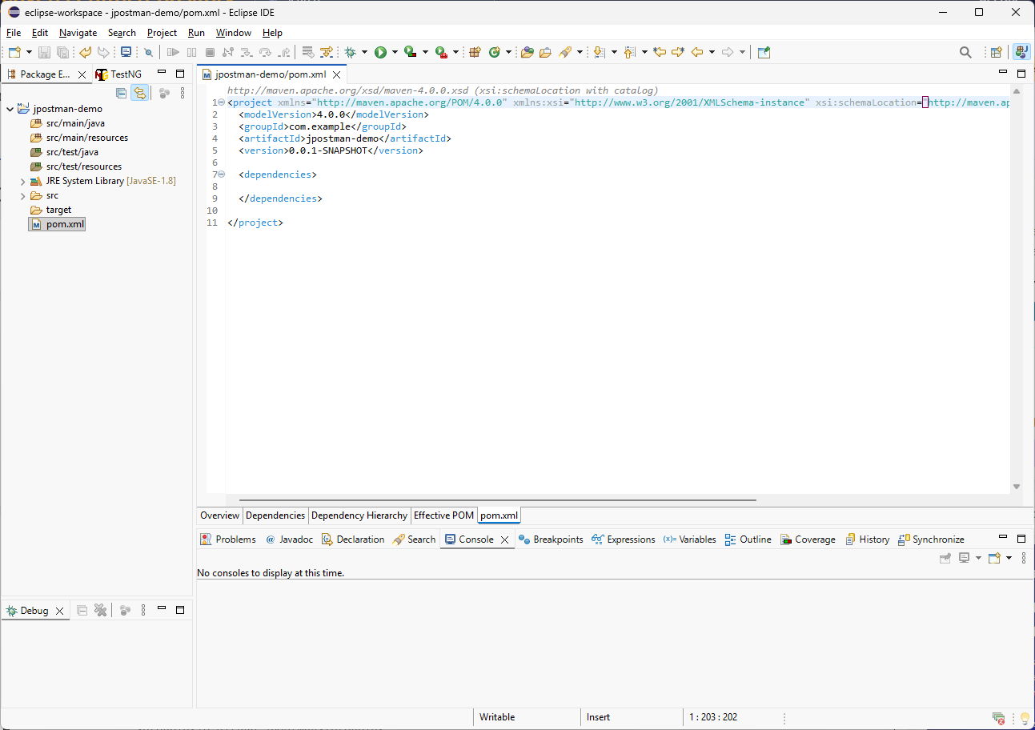
Before I paste the dependency from the clipboard, I need to create the dependencies management section in the pom.xml file. After that, I will paste the copied JPostman dependency inside this section.

Slide 15
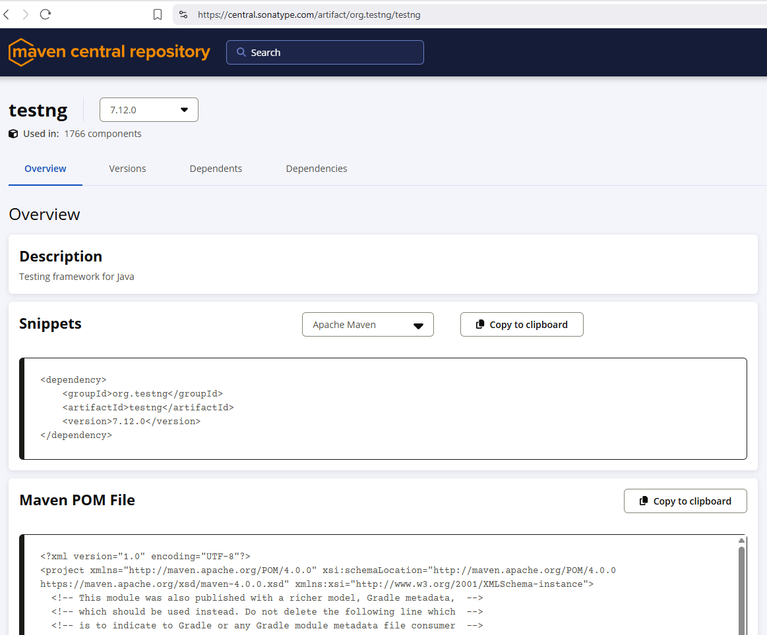
I will also add TestNG as a dependency for writing Java test scripts. However, you can use another test automation framework if you prefer, such as JUnit, Cucumber, or any framework that works with your project.

Slide 16
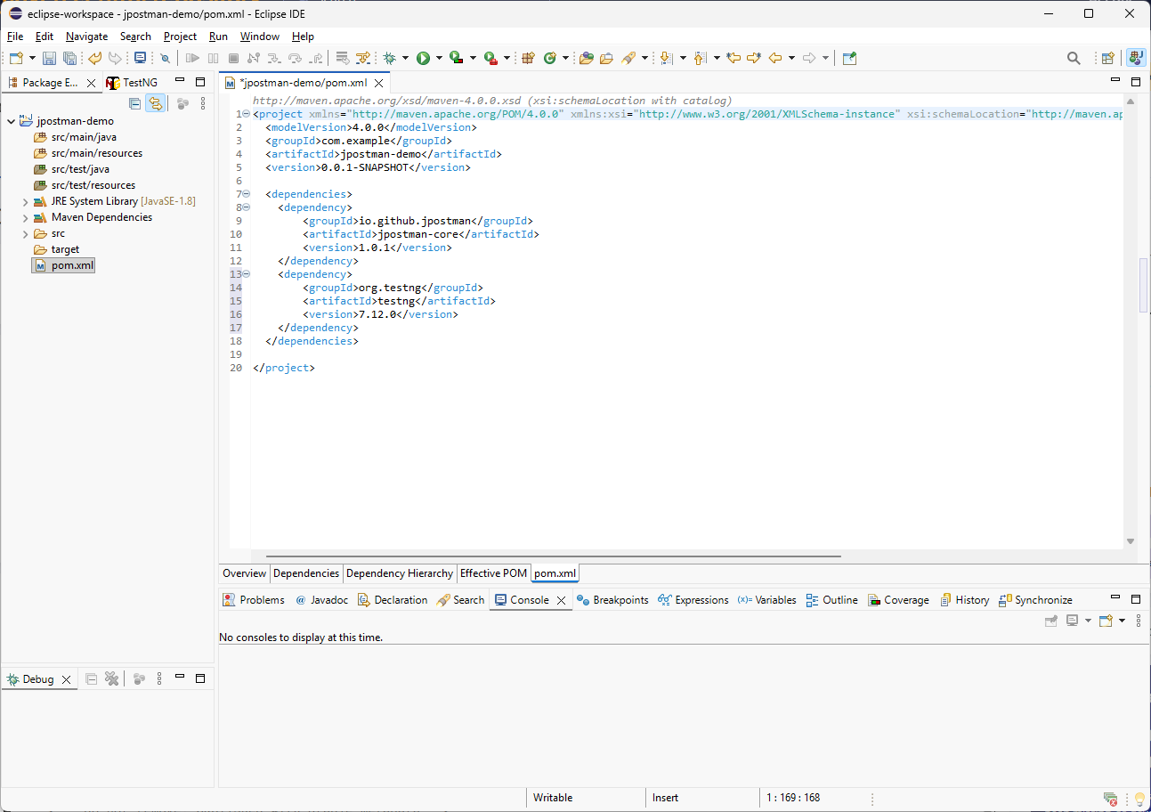
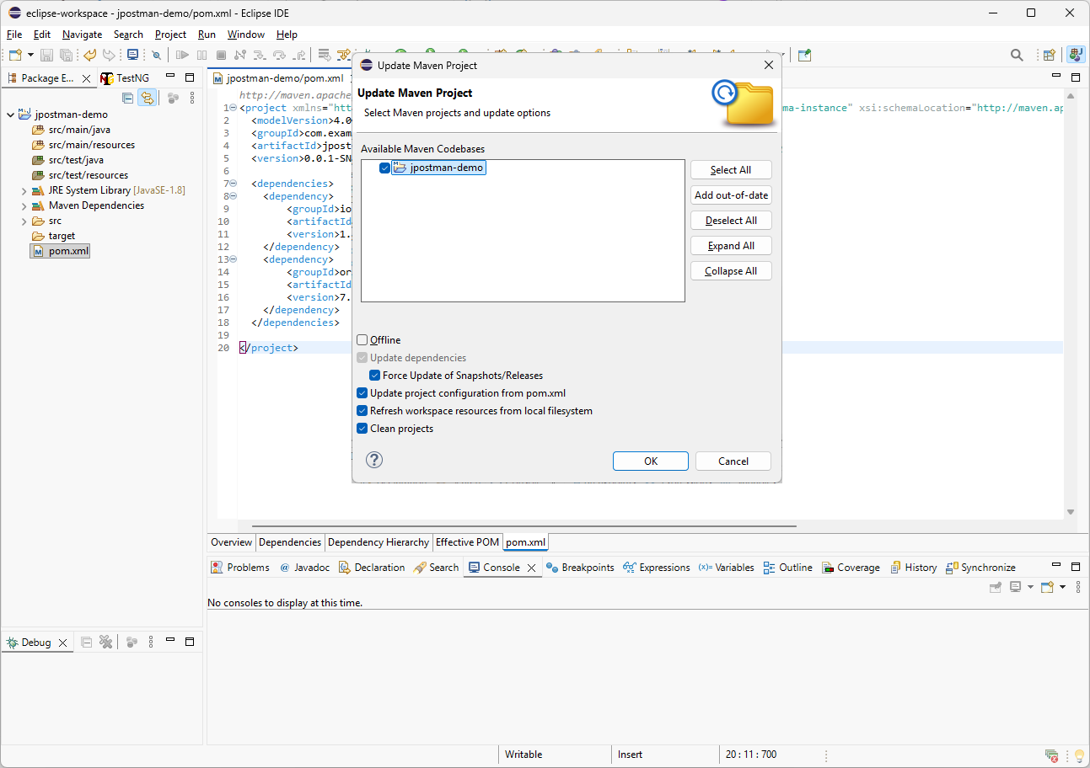
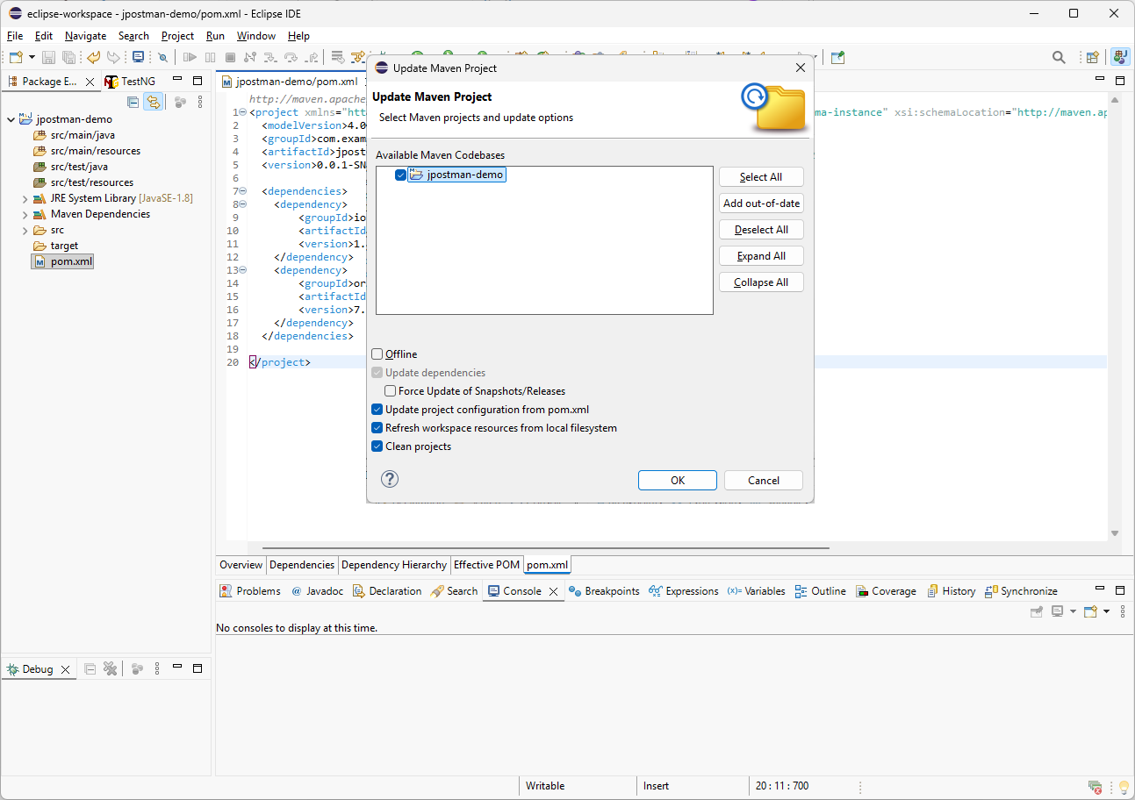
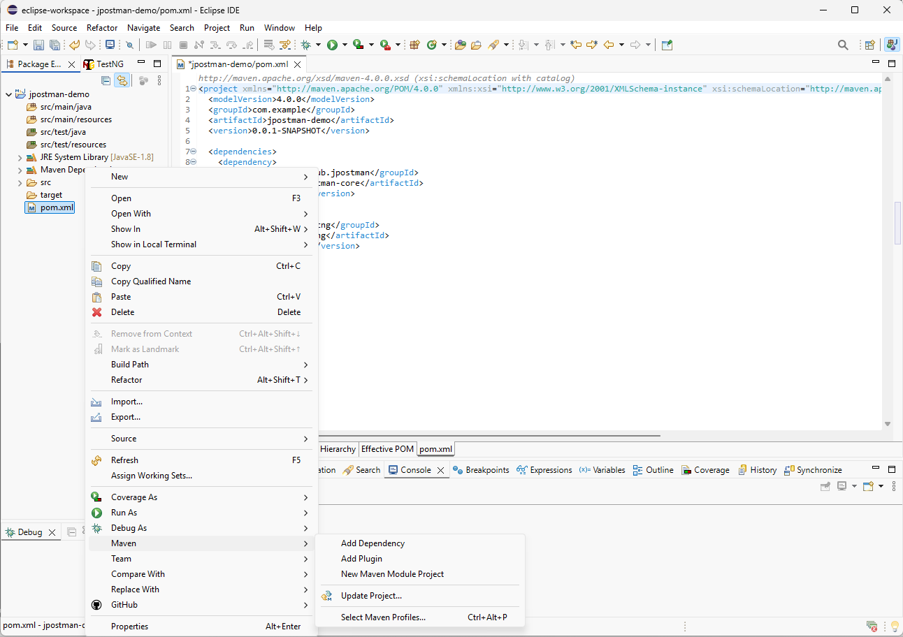
The last setup step is to update the Maven project so Eclipse downloads the required dependencies. I will right-click the pom.xml file, go to Maven, and select Update Project. Before clicking OK, I will enable Force Update of Snapshots/Releases.

Slide 17
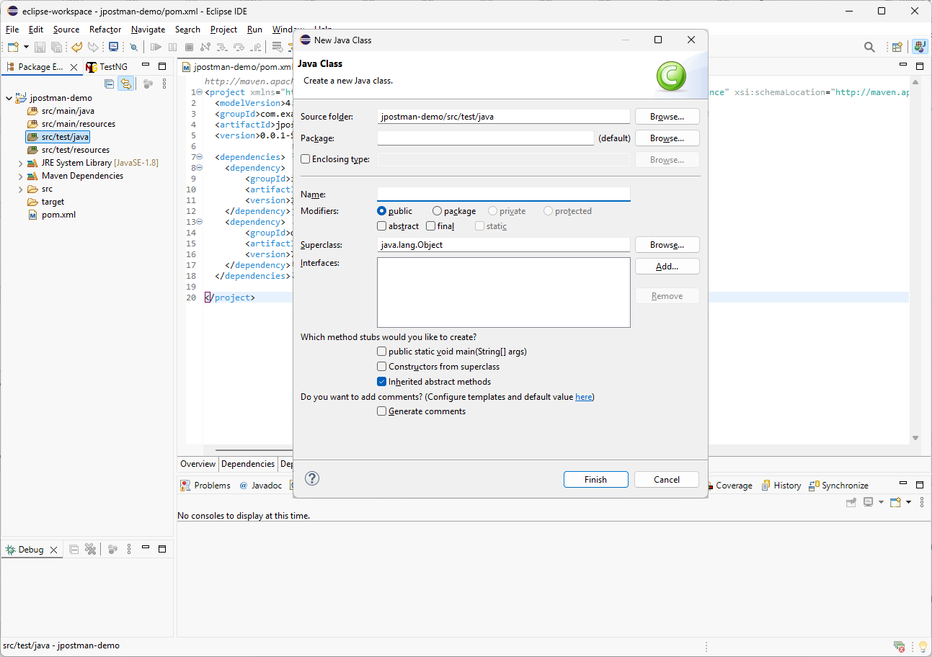

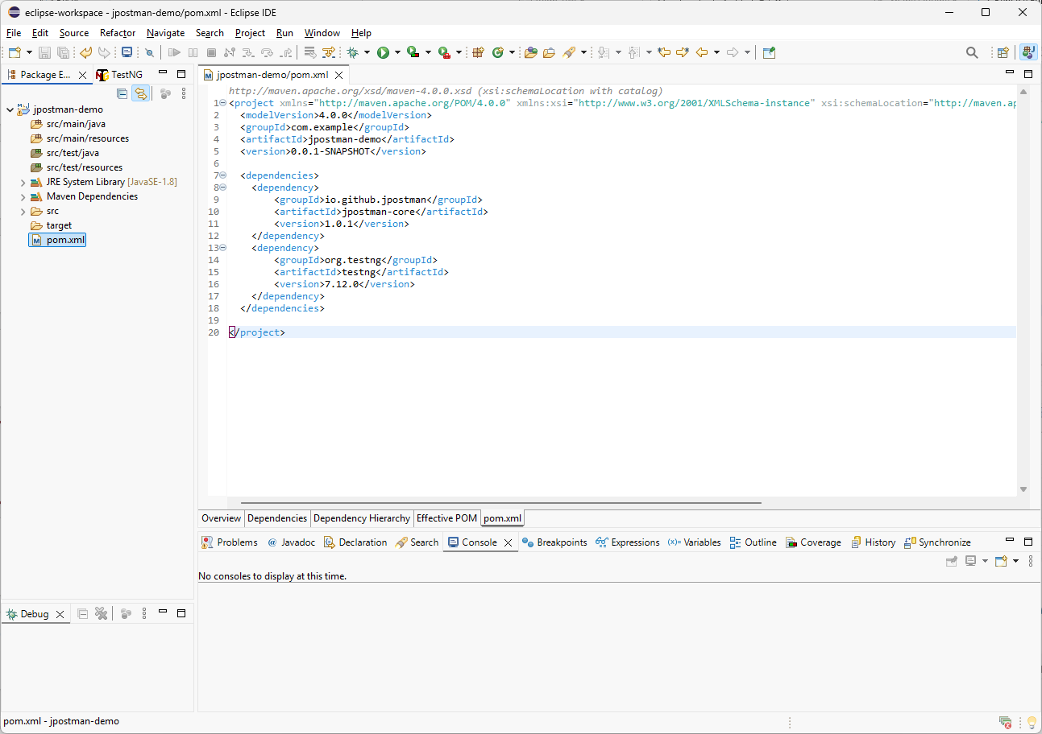
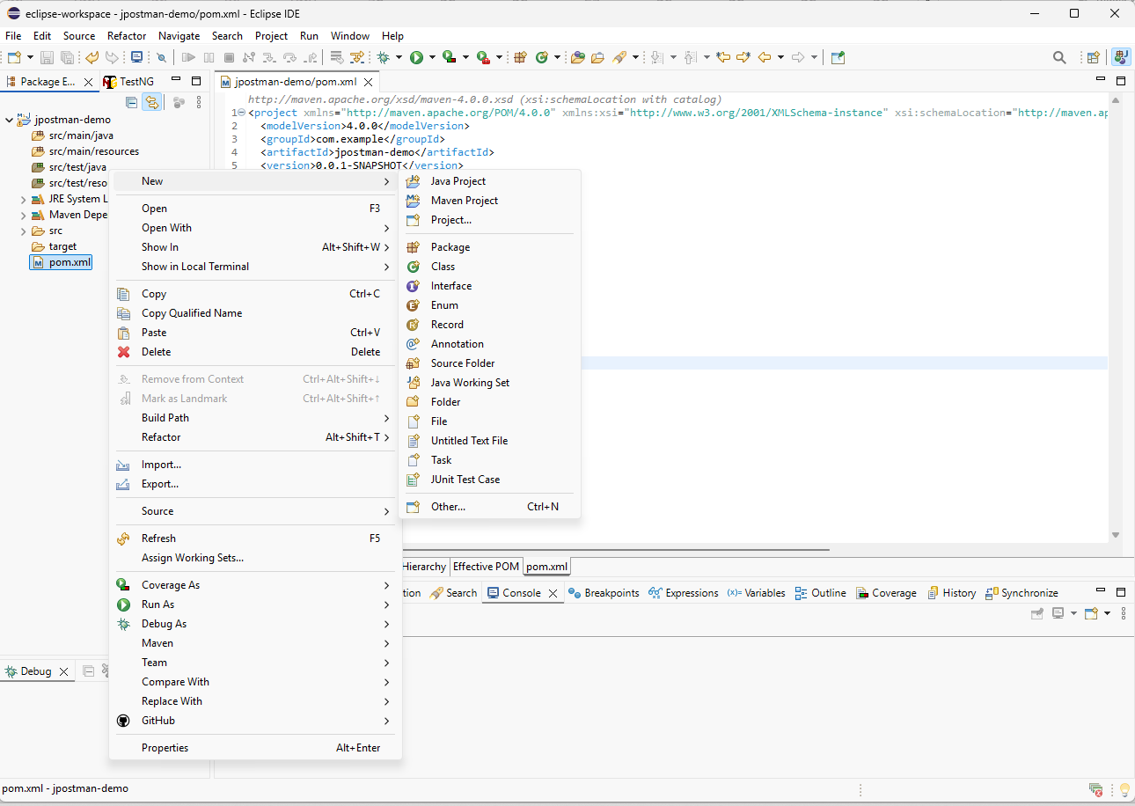
DemoTest
To create a Java test class, I will use the Maven src/test/java folder. I will right-click the folder, choose New, and then select Class. In the dialog, I will enter the class name, optionally define a package name, and click Finish.

Slide 18
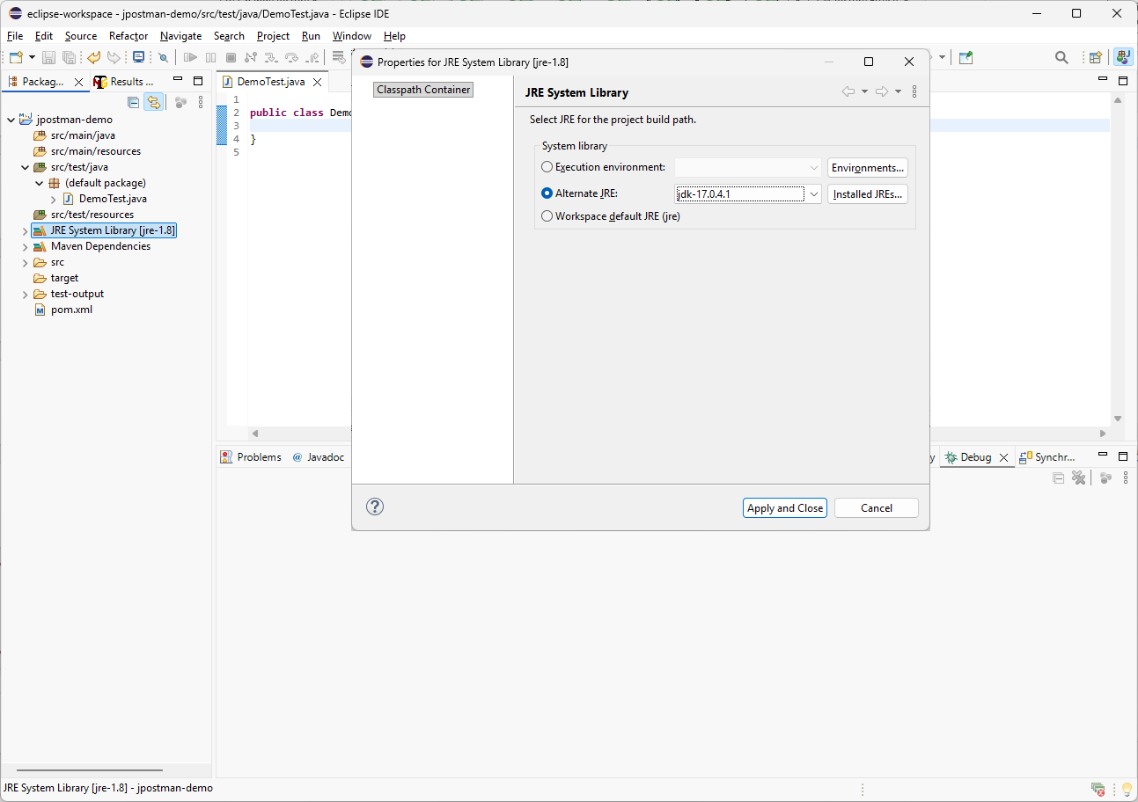
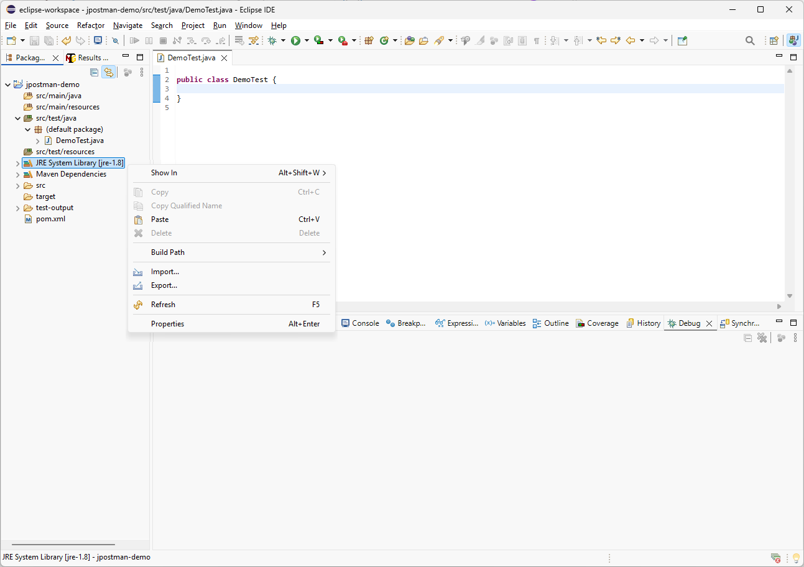
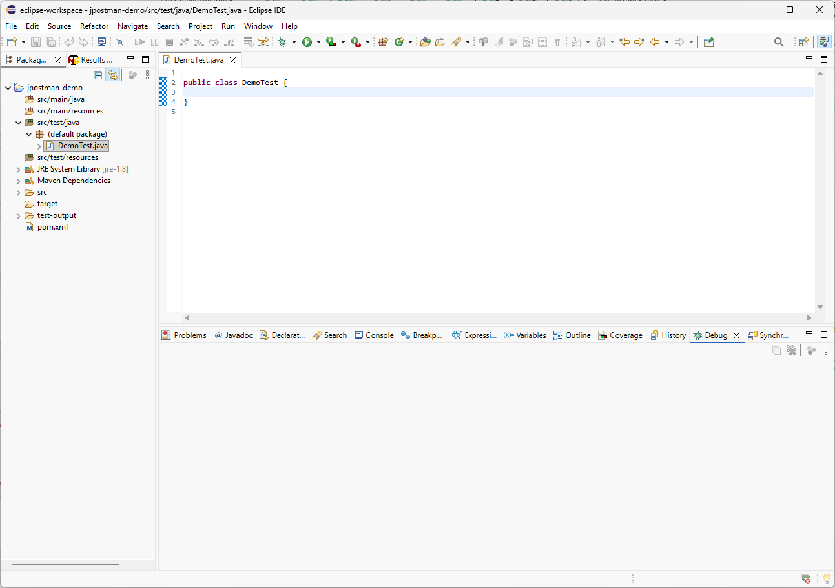
First, we need to make sure the project is using JDK 11 or higher. In my case, I will right-click the JRE System Library, open Properties, select Alternate JRE, choose Java 17, and click Apply and Close.

Slide 19
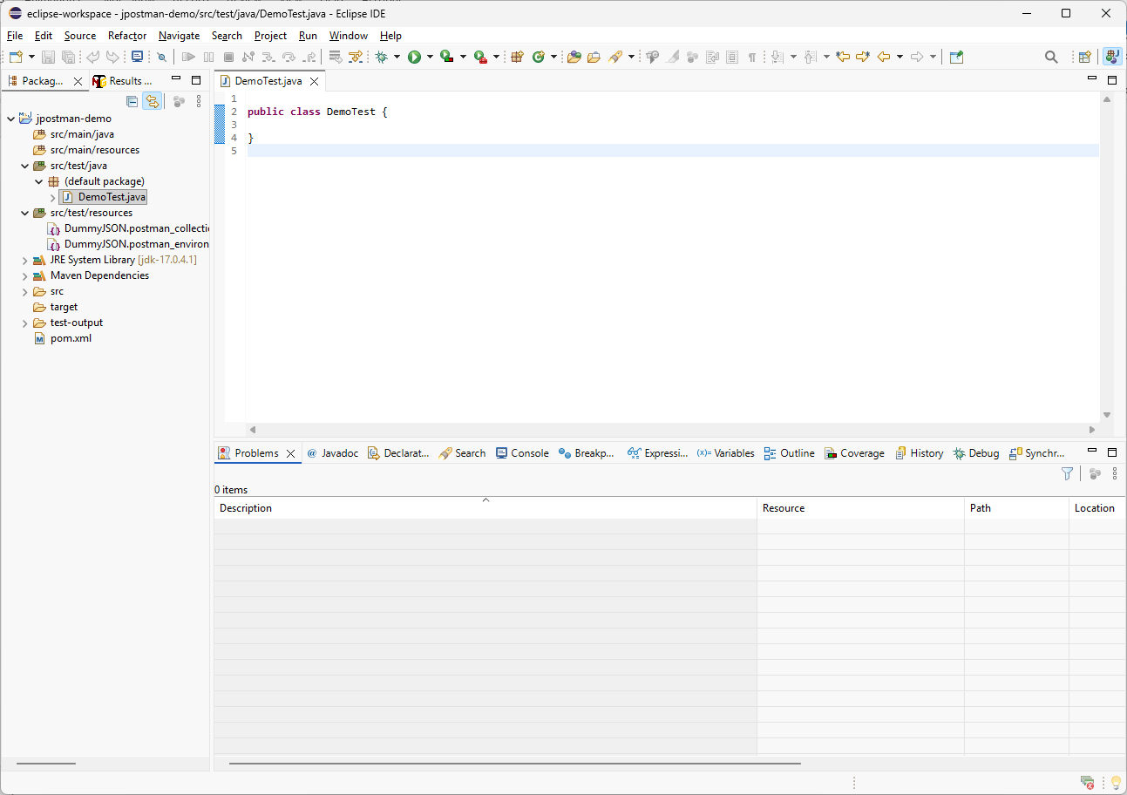
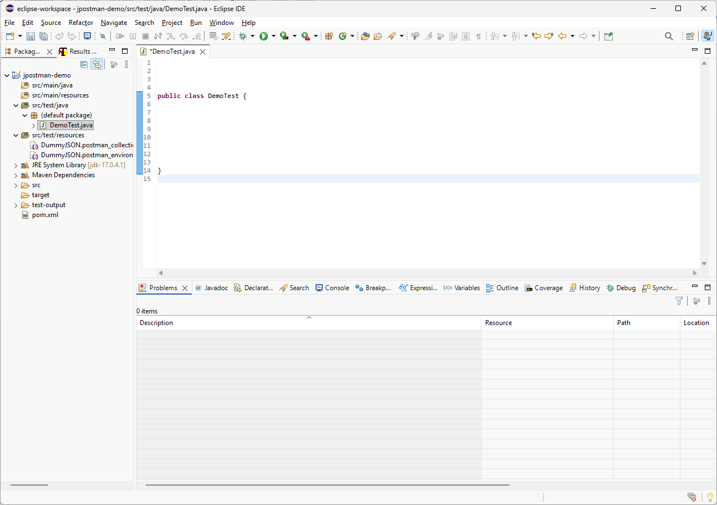
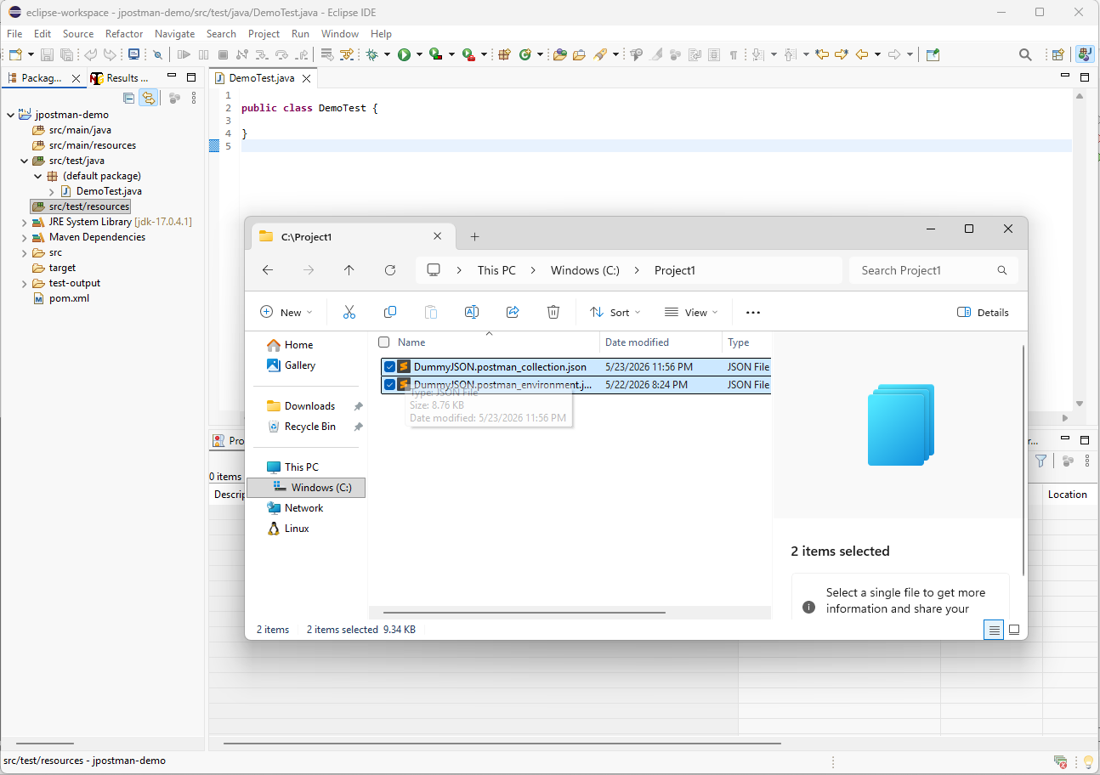
Drag both exported Postman JSON files into src/test/resources, then add spacing in the Java test class to prepare for writing the code.

Slide 20
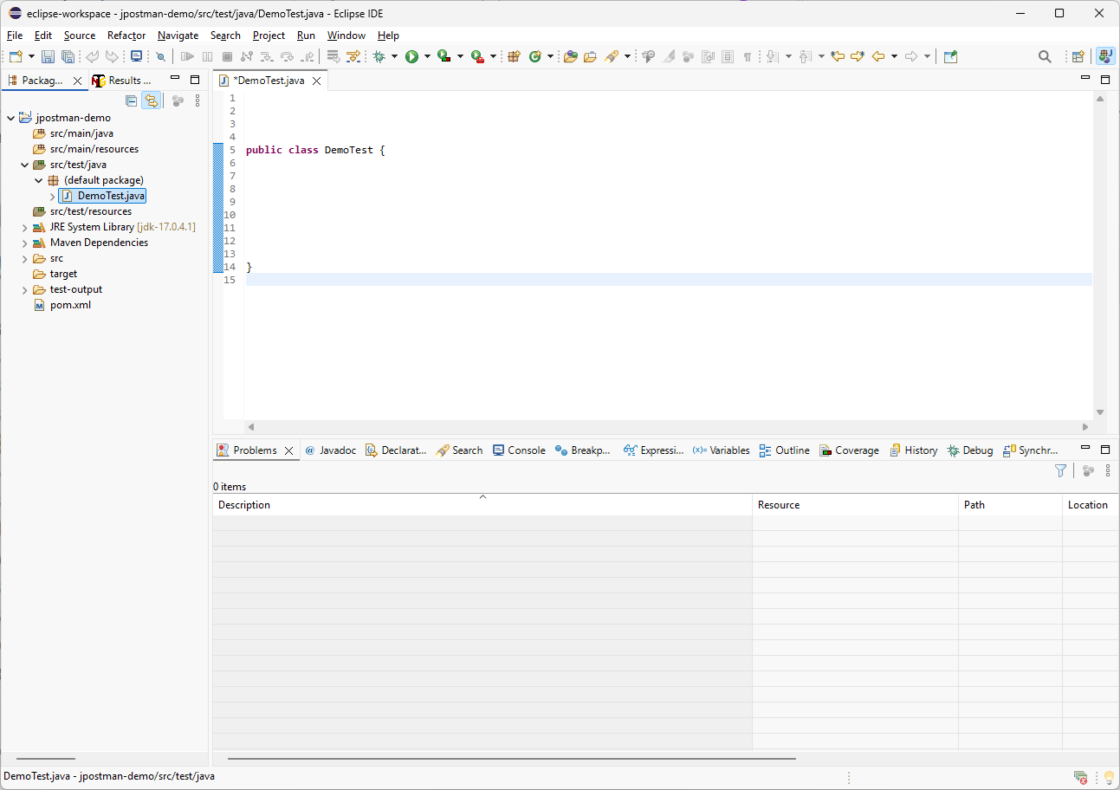
import org.testng.annotations.Test;
import io.jpostman.JPostman;
import io.jpostman.JPostman.Context;
@Test;
public void test1() throws Exception {
}
First, I will add the TestNG annotation and create a test method that will be executed by the test runner. Then I will add the required JPostman classes, including JPostman and Context, and paste the implementation that loads the collection and environment JSON files from the project resources folder.

Slide 21
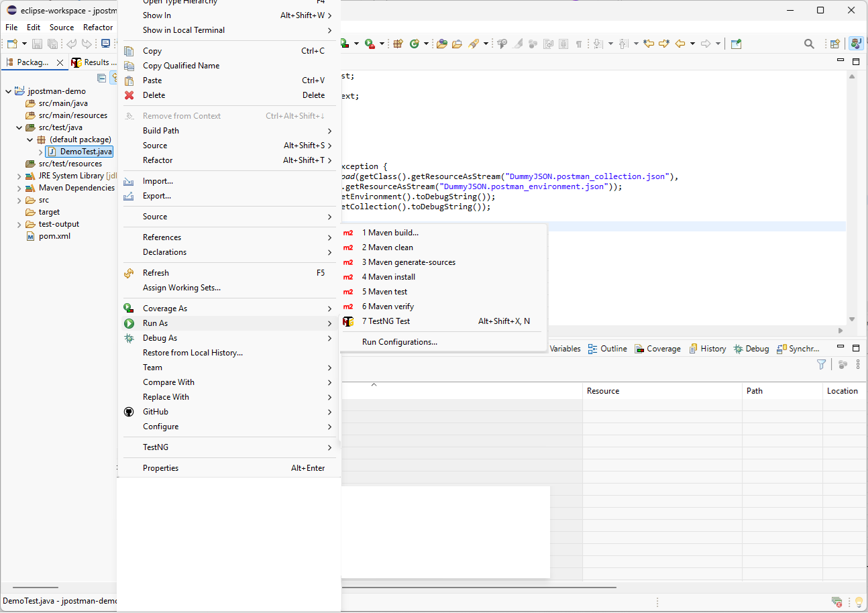
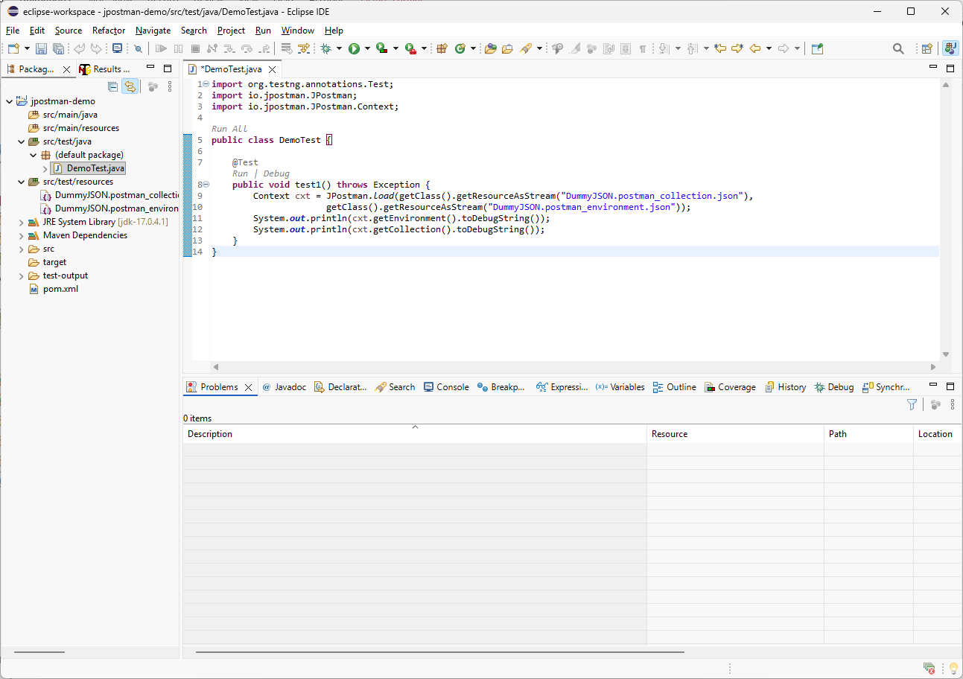
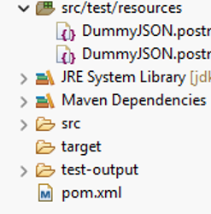
After saving the Java class, I will right-click the file and choose the runner for execution. Since this project uses TestNG, I will open Run As and select TestNG Test.

Slide 22
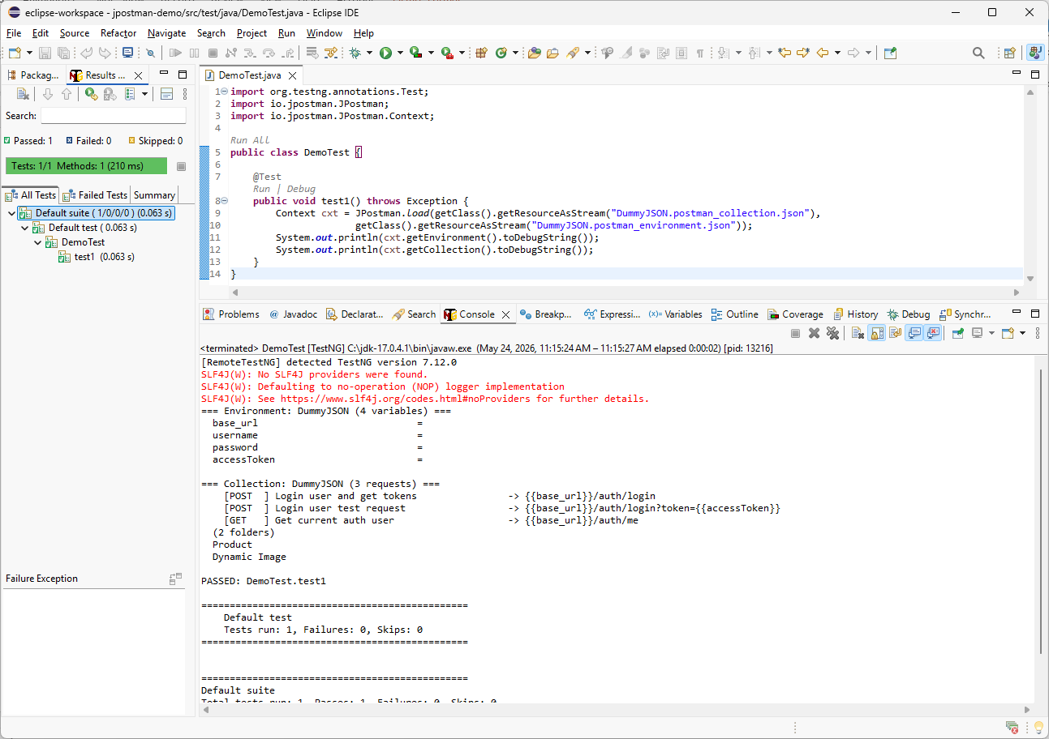
Congratulations! The Java project is now configured with JPostman. In the next tutorial, we will execute multiple API requests using Java HttpClient, REST Assured, Playwright, and Unirest. Thank you for watching, and I’ll see you in the next tutorial.

